Slide 1

Department of Computer Science & Engineering
Artificial Intelligence & Machine Learning
A.P. Shah Institute of Technology
G.B.Road, Kasarvadavli, Thane(W),
Mumbai-400615
UNIVERSITY OF MUMBAI
Academic Year
2023-2024

Slide 2

MediAlert – healthcare app
By
SAMARTH LOKHANDE - 23206012
DEVANSHU MANCHEKAR - 23206005
IKRA SAYYAD - 23206006
PURVA PAWAR – 23206009
Project Guide
Prof. Shraddha Dalvi

Slide 3
Outline
Introduction
Literature Survey of the existing systems
Problem statement
Flowchart
Technologies and methodologies
Implementation
Limitations of the existing systems
Conclusion
References

Slide 4
Introduction
MediAlert, the revolutionary Medicare app that's changing the game in medication management. Get ready to explore the exciting features and benefits of this smart app. Never miss a dose again with our smart medication reminders. Set personalized schedules and receive timely notifications to ensure you stay on track with your medication regimen.
Our app can contribute to better health outcomes by ensuring that users take their medications on time. This, in turn, can lead to improved management of chronic conditions and overall well-being.
Timely medication reminders can be critical, especially for medications that are vital to life. Our app has the potential to save lives by preventing missed doses and reducing the risk of complications.
Forgetfulness is a common reason for medication non-adherence. Our app can help bridge this gap by sending reminders and notifications, addressing a common challenge faced by many individuals.

Slide 5
• Engaging patients in their own healthcare can lead to better health outcomes and patient satisfaction. A medication alert system empowers patients by providing them with tools and resources to manage their medications effectively and take an active role in their treatment plans.
• A medication alert system can facilitate communication and information sharing between patients, caregivers, and healthcare providers. This can improve coordination of care, ensure accurate medication lists, and enhance patient safety.
• Patients with chronic diseases often require long-term medication therapy to manage their conditions effectively. However, maintaining medication adherence over the long term can be difficult. A medication alert system can support patients in managing their chronic conditions by reminding them to take their medications regularly.

Slide 6
Literature Survey of the existing system
A study on Mobile apps in the Healthcare Industry : by Balagopal Ramdurai May 2021
Overall, health app downloads have increased by 25% during the pandemic.Covid-19 has emphasized and increased the use of digital health tools, and that while some have found it challenging, others have embraced it . Now, and when life has come back to normal, people should continue to harness digital health to address the health and service issues left by Covid-19 and not lose the gains that digital health has provided over this period, the report said.
Medical applications: a database and characterization of apps: Jill de Grood and William A Ghali 27 august 2014
The team defined target audience by the role of the groups who would use the app When an app might be used by a person who is under health provider care or managing a long-term condition such as diabetes, the team characterized it as a patient app. A number of filtering processes were applied to the data at the time of collection and during refinement to ensure data quality.

Slide 7
• Designing a health reminder application,a UX case study: Ashwini Kalmane Jun 25 2019
The App aims to provide support to people that they need to take their medications the way they’re supposed to and to never miss their health care appointmentss. It also acts as a perfect companion for those who need a mobile organizer for regular medications.
• Developing the Medication Reminder Mobile Application: Asghar Ehteshami, and Ali Samimi 2017 Jun; 25(2): 108–111
It is expected to reduce medication error and improve patient adherence to medical prescriptions.Fulfillment of outpatients’ prescribed medication is an important part of the self-care process, because it is related to patient safety and it can cause serious problems for patients’ health as well as threatening their safety.

Slide 8
Problem statement
• Nowadays, everyone is trying to focus in on their well being in their everyday occupied lives. Medication non-adherence remains a significant challenge in healthcare, leading to adverse health outcomes, increased healthcare costs, and reduced quality of life for patients. Despite the availability of medication reminder applications, many individuals still struggle to adhere to their medication regimens effectively.
• Accessibility barriers, such as language barriers, visual or hearing impairments, and limited internet connectivity, can exclude certain populations from accessing and benefiting from our app. Ensuring accessibility and inclusivity through multi-language support, alternative communication channels, and offline functionality is essential for reaching underserved communities.
• Constant reminders can desensitize users, leading to reminder fatigue where alerts are ignored or dismissed without action. Balancing timely reminders with user preferences and behavioral patterns is essential to maintain effectiveness without causing annoyance or frustration.
• They may worry about the safety of their personal health information, the risk of data breaches, or the potential for unauthorized access to their medication data.

Slide 9
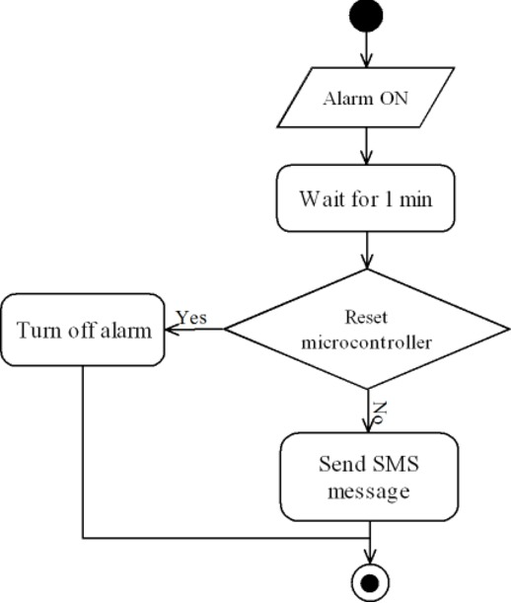
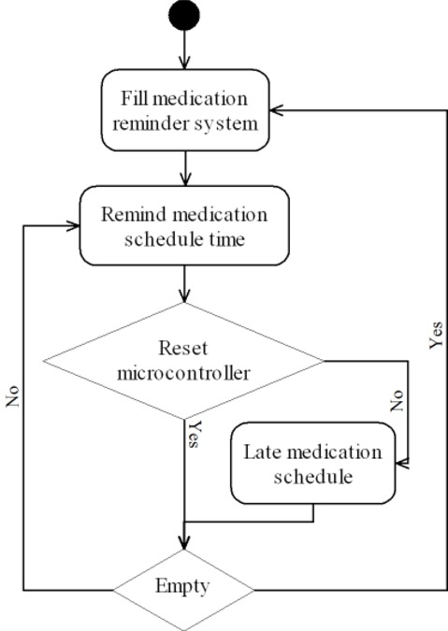
Flow Chart

Slide 10
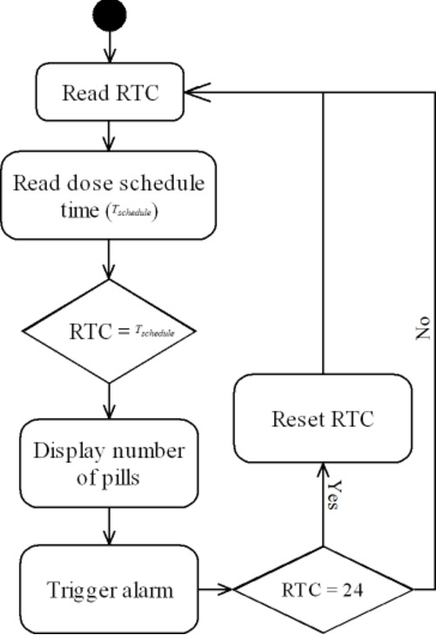

Slide 11
Technologies and methodologies
• Java
It simplifies the development process and offers features like dependency injection, security, and data access.
• Firebase
Firebase Database is the Realtime Database based on your specific requirements. Firebase is NoSQL database, and they provide real-time data synchronization.
• Figma
Design the user interface (UI) using Figma. Figma is a collaborative design tool that allows for real-time collaboration and prototyping.
• Git
Use Git for version control to track changes, collaborate with a team, and manage the source code of your application.

Slide 12
• Android Studio
Android Studio is the official IDE for Android app development. It provides a powerful environment for building, testing, and debugging Android applications.
• Test-Driven Development (TDD)
Write tests before implementing features to ensure code reliability and facilitate easier maintenance.
• Design Patterns:
Use design patterns to solve common design problems and create maintainable code.
• Code Reviews:
Conduct regular code reviews to ensure code quality, adherence to coding standards, and knowledge sharing among team members.

Slide 13
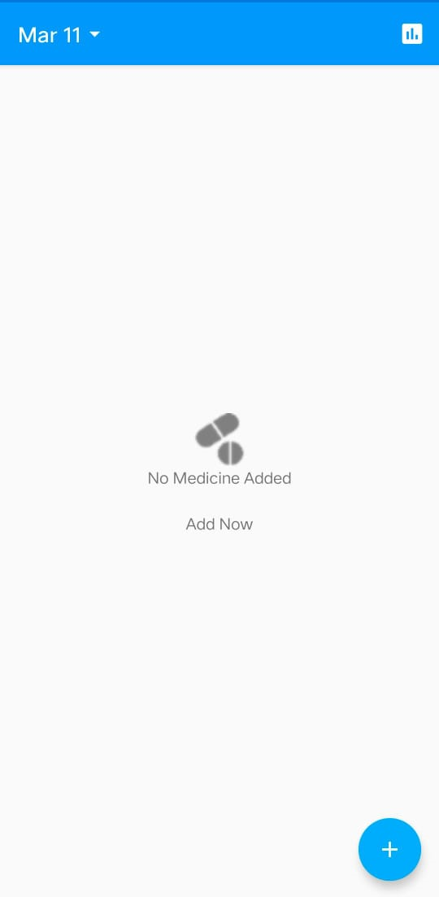
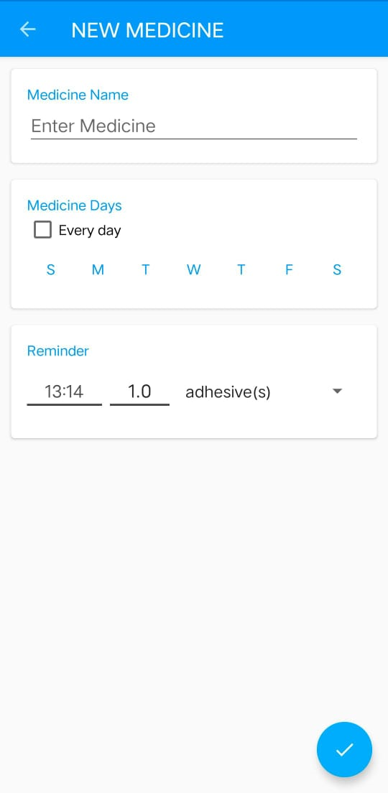
Implementation

Slide 14
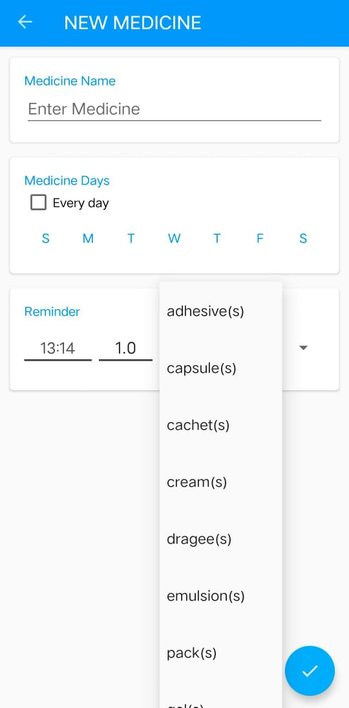
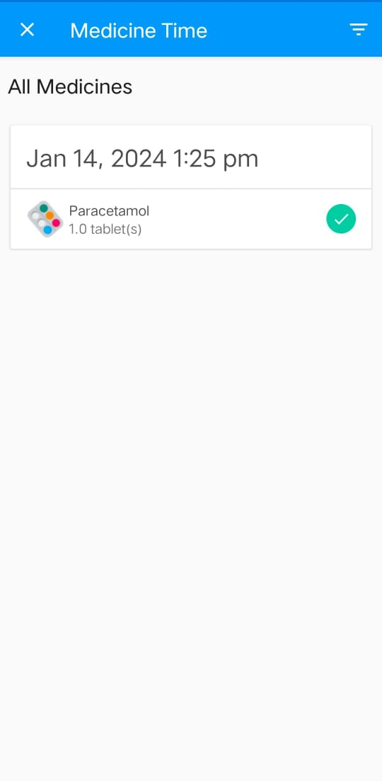

Slide 15
Limitations of Existing Systems
User Engagement: Sustaining user engagement with the app over time can be challenging. Some users may become desensitized to notifications or may forget to use the app altogether.
Complex Medication Regimens: While some medication alert apps can handle relatively complex medication schedules, they may struggle with extremely intricate regimens or situations where medication timing is crucial.
Privacy and Security Concerns: Medication alert apps often handle sensitive health information. Therefore, ensuring robust privacy and security measures to protect user data is critical but can be challenging to implement effectively.
Integration with Healthcare Systems: Integrating medication alert apps with electronic health records (EHRs) or other healthcare systems can improve accuracy and provide additional functionalities. However, achieving seamless integration can be technically challenging and may require cooperation from healthcare providers and institutions.

Slide 16
Conclusion
Here we conclude, Thank you for joining us on this journey to explore the incredible capabilities of MediAlert. Embrace the future of medication management and empower yourself with this smart MediAlert app. ​
MediAlert is poised to revolutionize medication management with its user-friendly interface, customizable reminders, and comprehensive tracking capabilities. rating into users' daily routines.

Slide 17
References
• A study on Mobile apps in the Healthcare Industry :by Balagopal Ramdurai May 2021
• Medical applications: a database and characterization of apps: Jill de Grood and William A Ghali 27 august 2014
• Designing a health reminder application,a UX case study: Ashwini Kalmane Jun 25 2019
• Developing the Medication Reminder Mobile Application: Asghar Ehteshami, and Ali Samimi 2017 Jun; 25(2): 108–111.

Slide 18
Thank You..!!

